Slide 1
What Is Protocol …?

Slide 2
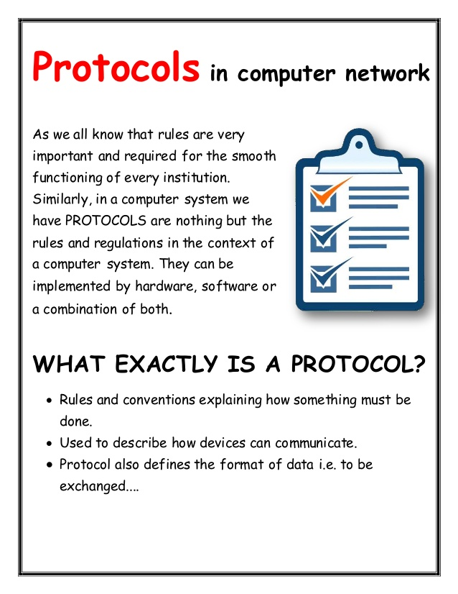

Slide 3
Requirements of Protocols
Data formats for Data Exchange
Flow Control
Routing
Acknowledgements
Loss of Information
Sequence Control

Slide 4
Protocol Functions
Identifies errors
Applies compression techniques
Decides On:
How to announce sent data
How to announce receive data
How to address data
How Data is to be sent

Slide 5
Need of Protocols
Protocols are needed to be predefined understandings for communications.
It helps the smooth functioning of a system, such contribution to a system may benefit or offend you from where you stand.
Eg. HTTP , FTP , TCP/IP Protocol.

